Slide 1
Github Analytics
Arun somasundaram

Slide 2
Objective
Analyze Five public Git repositories
Opencv
Tensorflow
Pytorch
SpaCy
Ant-design
Generate insights
Throughput
Bandwidth
Trends
Identify areas of weak or strong performance
Automate the process
Apply automation on additional repositories

Slide 3
Approach
Browse the target repos in Github.com
Explore issues, pull_requests, Insights (commits, code frequency, contributors) features
Explore search criteria on all the above
Read and understand documentation on API search
Determine the metrics to be analyzed
Perform manual search on one repository for one measure and visualize
Write Python script to generate the metrics for other repositories and other measures
Use Tableau to visualize the metrics

Slide 4
Measures Analyzed
Issues
Created Count
Closed Count
Throughput (Derived)
Pull Request
Created Count
Closed Count
Linked to Issues
Comments(interactions) Count
Commit
Count
Merge:true or false
Contributions by individuals
Weekly Additions
Weekly Deletes
Weekly Commits
Code
Additions
Deletions

Slide 5
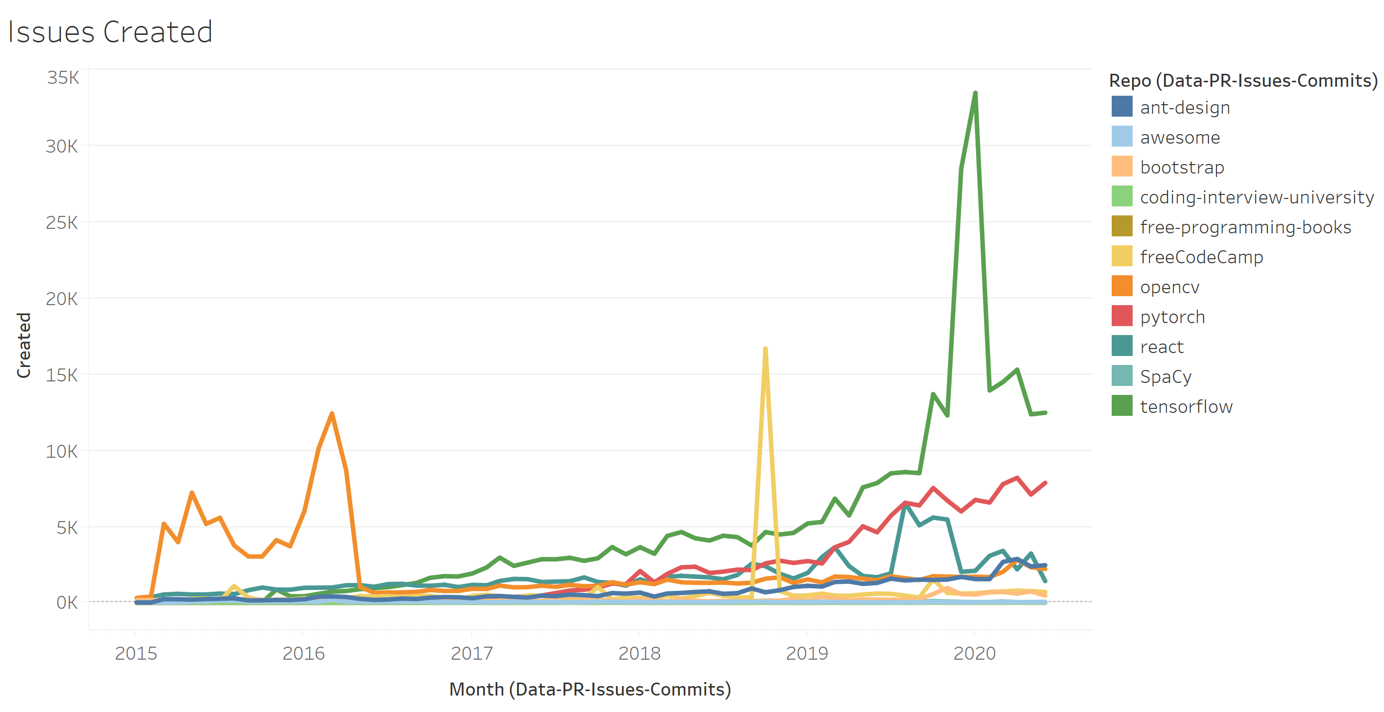
Measure 1 : Issues Created
Collected Monthly count of issues created since 2015
Used in measuring the throughput
Issues Growth can be used to calculate bandwidth.
Repositories have varying degree of issues count however, the general trajectory is upward
There are spikes in certain month for some repositories which should be inspected

Slide 6
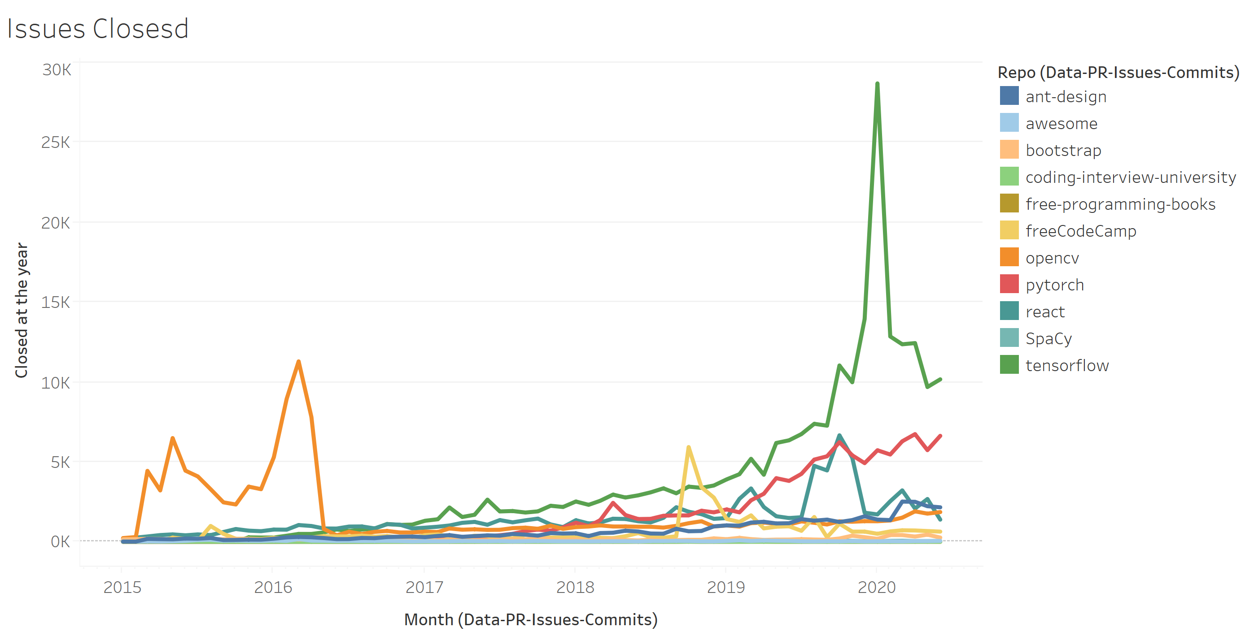
Measure 2 : Issues Closed
Collected Monthly count of issues closed since 2015
Used in measuring the throughput
This can be used to calculate the bandwidth
Observed that the different repositories have slightly varying degree of closure however the trajectory is upward.
There are spikes in certain month for some repositories which is good but needs to be understood

Slide 7
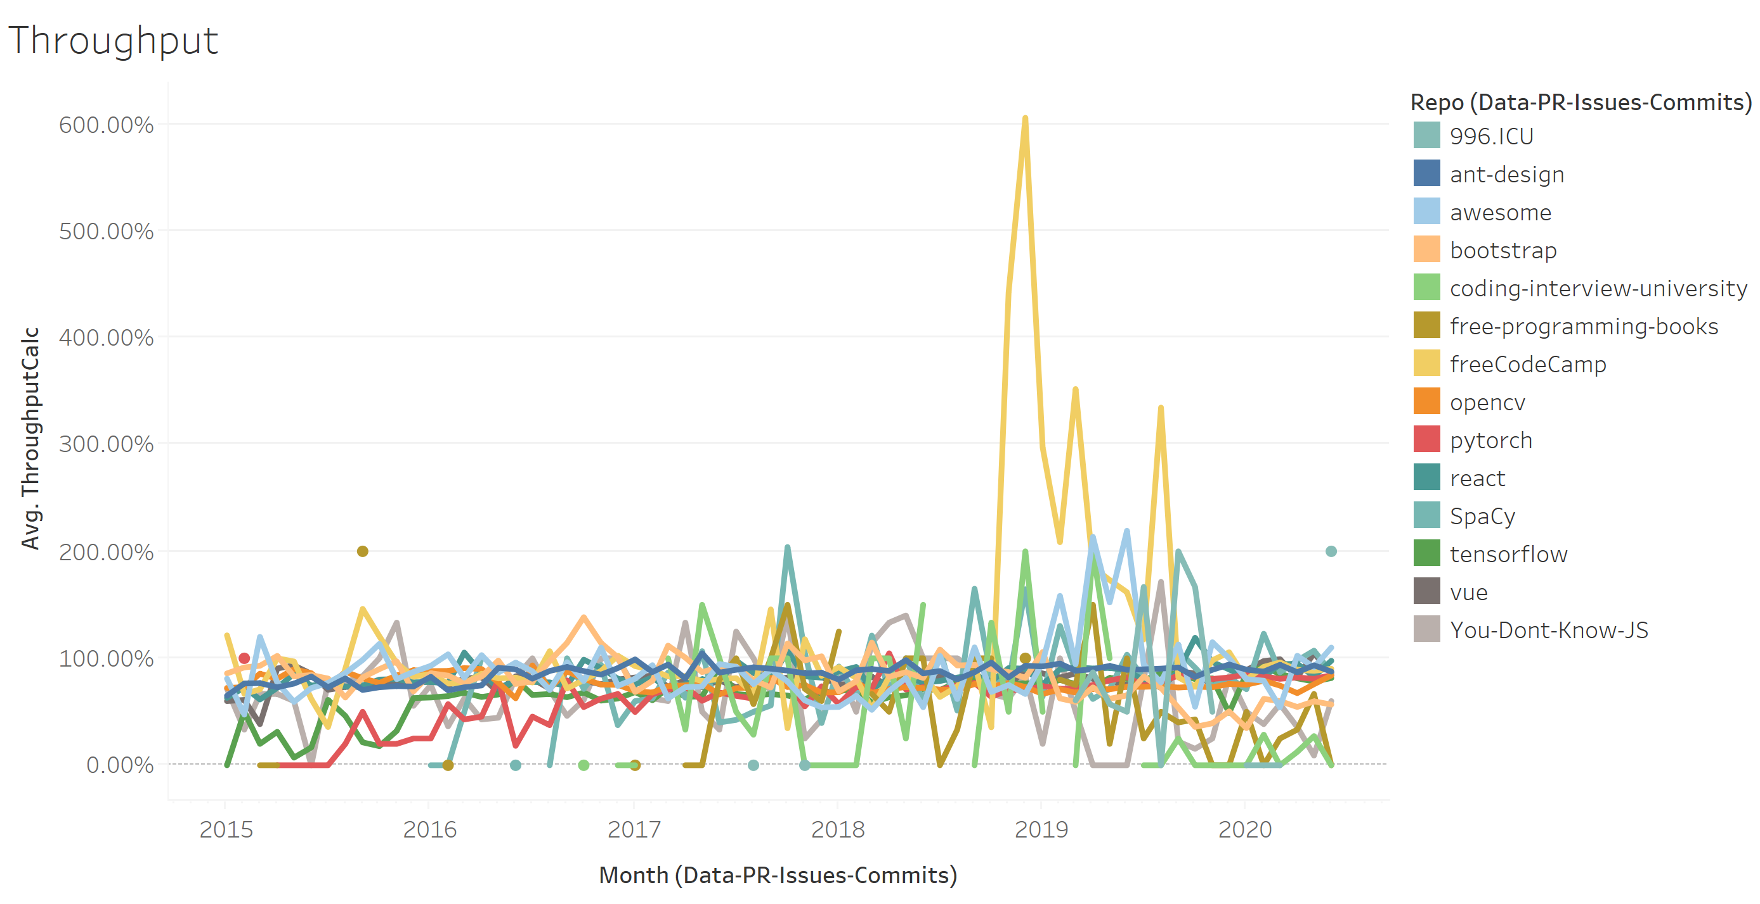
Measure 3 : Throughput
This is calculated as a percentage of IssuesClosed over IssuesCreated montly
Factors impacting the throughput are wide
Complexity
Bottleneck in Pull Request process
Team size
Responsiveness
Observed that the throughput is generally in 80% range.

Slide 8
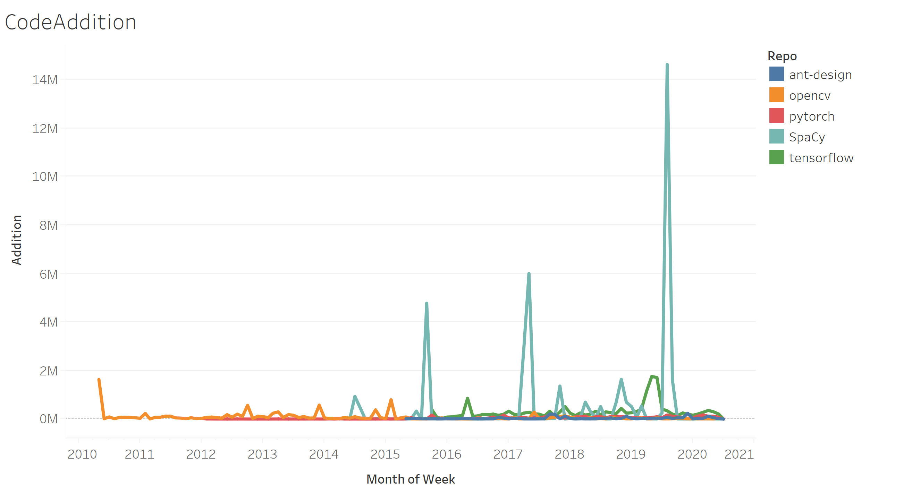
Measure 4 : Code Addition / Deletion
Data collected weekly addition /deletion at the repo level as well as the contributor level
High code addition can be tied to issues created later
Individual participation can be measured
Also computed
Code addition per contributor
LOC : Issue ratio
Observation : Some repos have high spikes in code addition in some months

Slide 9
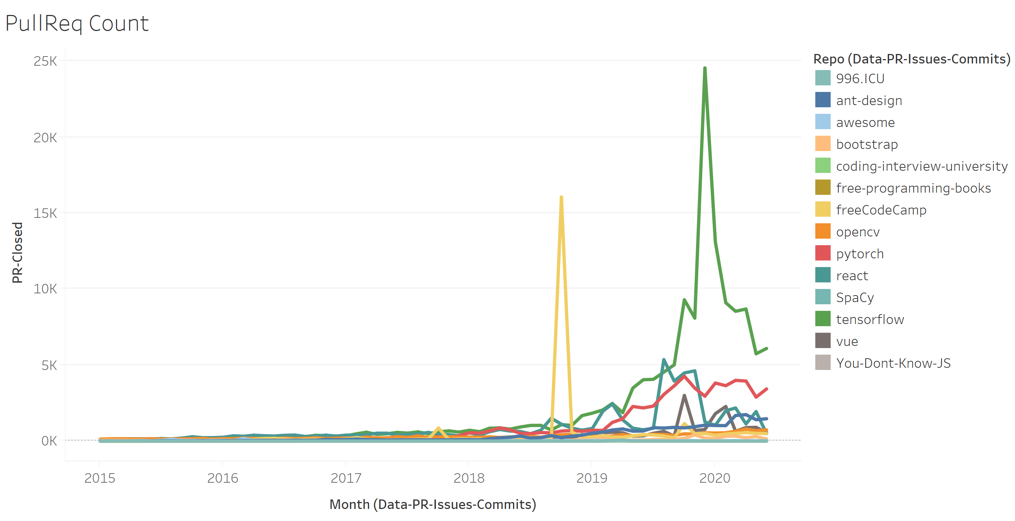
Measure 5: Pull Request Count
Pull Requests are key to solving issues
Data for Monthly count of pull requests created was collected
Additional slice of data where pull requests were linked to issues was collected
This could indicate how disciplined the team was in handling the pull requests
Additionally data for the pull requests that had comments was also collected
This could indicate the health of the change management
Although not collected it is possible to compute the Turn around time for pull requests
Observed that the different repositories have slightly varying degree of PR however the trajectory is upward.
There are spikes in certain month for some repositories which is good but needs to be understood

Slide 10
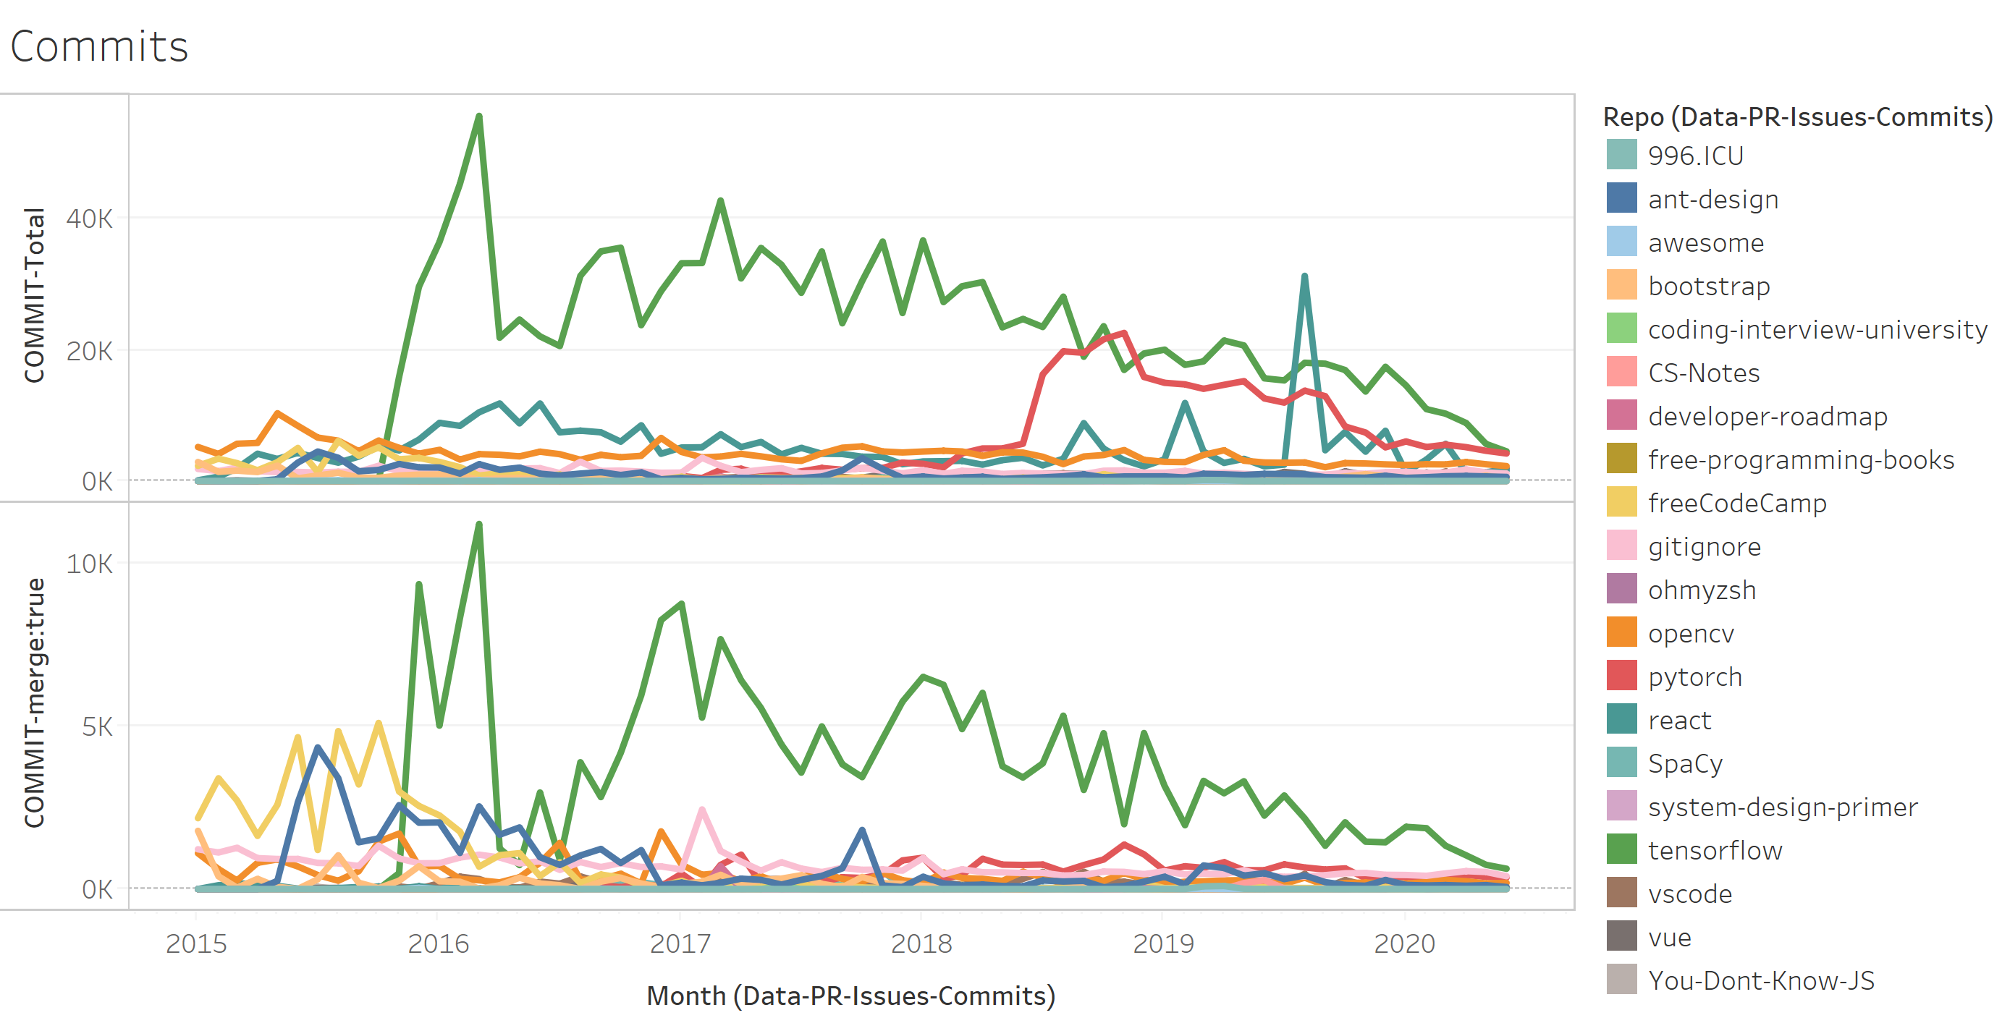
Measure 6: Commit count
Data was collected for monthly count of commits to the repository
Slice of data whether the commit was ultimately merged was also collected
Although not collected, it is possible to collect the turn around time and the commits linked to issues
Observed that commits count and percentage of merged commits in all repositories are generally range bound

Slide 11
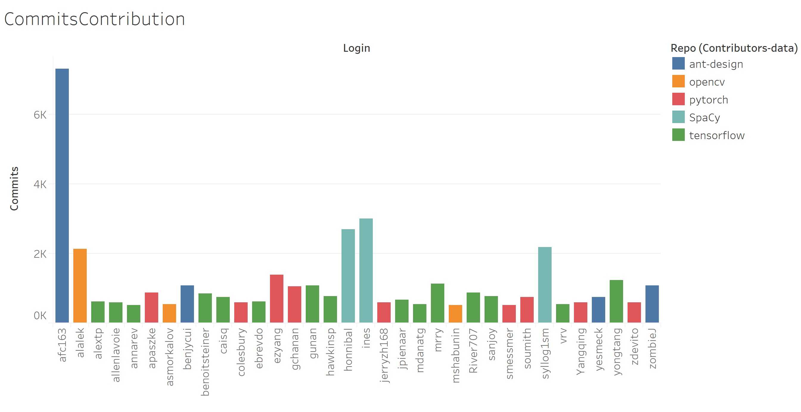
Measure 7 : Contributions
Weekly contributions (commit count) by individuals were collected but rolled up.
This can indicate the engagement of individuals.
Some Repositories have one anchor contributor supported by strong contributors

Slide 12
Key Performance Measures Ranked
 | Spacy | pyTorch | Tensorflow | Opencv | Ant-design
IssuesCreated(low=1) | 1 | 3 | 5 | 4 | 2
Issues Closed(high=1) | 5 | 3 | 1 | 2 | 4
Throughput (high=1) | 2 | 5 | 4 | 3 | 1
Code Additions(low=1) | 5 | 2 | 4 | 3 | 1
Code Deletions(low=1) | 5 | 2 | 4 | 3 | 1
PRcomments >20(high=1) | 5 | 2 | 1 | 3 | 4
PRcomments=0(low=1) | 1 | 4 | 5 | 2 | 3
Merge Commit(high=1) | 1 | 2 | 5 | 3 | 2
LOC to Issue (high=1) | 4 | 1 | 5 | 2 | 3

Slide 13
Automation
https://github.com/asomasundaram/GitInsights
Python
Github
Uses openpyxl, jsonpath_ng libraries
The inputs are defined in Excel itself
Functions are parameterized
Takes Github developer security token as the argument
Computes 66 months of 13 measures per repo
Takes an ~hour to process a repo with the rate limit of 30 per minute
Rest API
Excel
Tableau

Slide 14
Automation (continued)
Calls to the Github REST API has rate limit constraints. For unauthenticated users the search APIs are limited to 10 calls per minute, for authenticated users the rate limit is 30 per minute. For corporate accounts the quota is 5000-12000 per hour.
The program makes a rate_limit call first before every search and waits until the next reset time if the quota is about to be exceeded. In the event the call fails it waits for a minute and retries.
Ideal architecture will have a database where data is collected at detailed level and refreshed periodically and stored with a proper database schema
For better user experience a web application is the best.

Slide 15
Additional Repositories automated
freeCodeCamp/freeCodeCamp
996icu/996.ICU
vuejs/vue
EbookFoundation/free-programming-books
facebook/react
twbs/bootstrap
sindresorhus/awesome
getify/You-Dont-Know-JS
jwasham/coding-interview-university
kamranahmedse/developer-roadmap
ohmyzsh/ohmyzsh
CyC2018/CS-Notes
github/gitignore
donnemartin/system-design-primer
microsoft/vscode
airbnb/javascript
flutter/flutter
torvalds/linux
d3/d3
Identified by querying for repos with > 90000 stars

Slide 16
Summary
Individual measures have limited insights. Measures should be corelated with other measures. This requires involved effort by Data Scientists and Software Engineers.
Analyzing repositories in automated fashion is a significant development and maintenance effort.
Build vs Buy : Products are available for buy: Velocity, GitPrime are good examples

Slide 17
Appendix

Slide 18
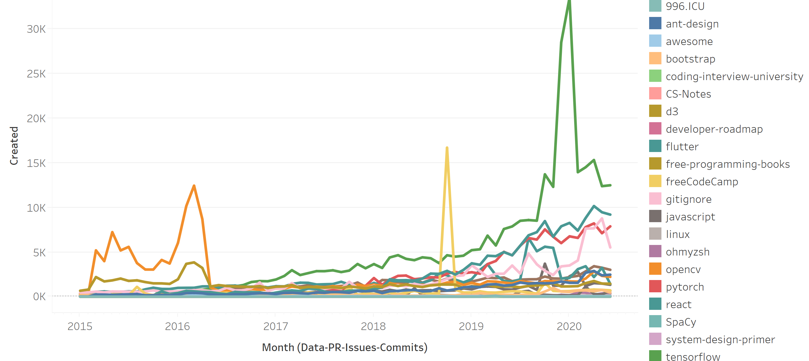
Issues Created
Monthly volume of issues by the repositories

Slide 19

Issues Closed
Monthly volume of issues closed by repositories.

Slide 20
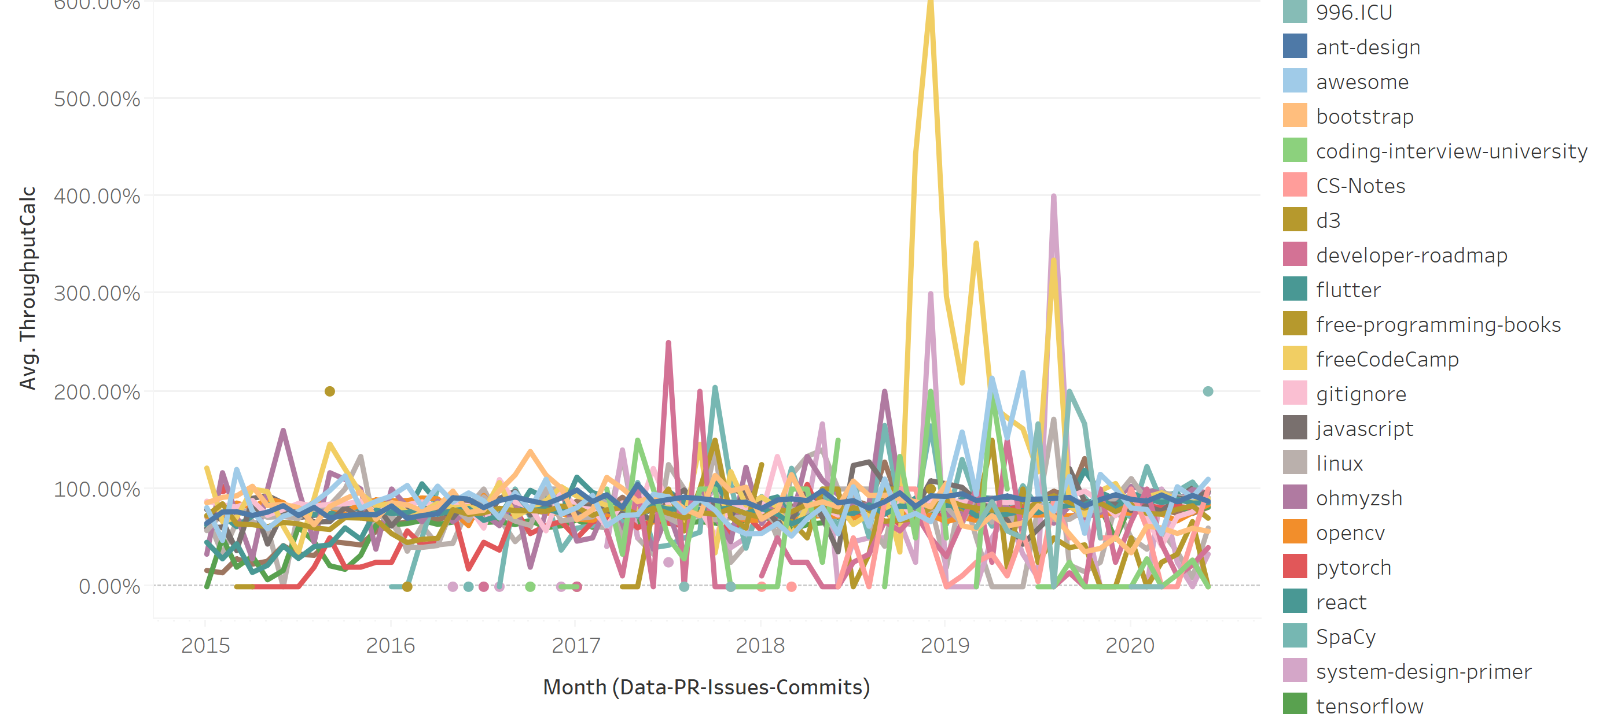
Throughput
Percent of issues closed over issues created. Calculated monthly.

Slide 21
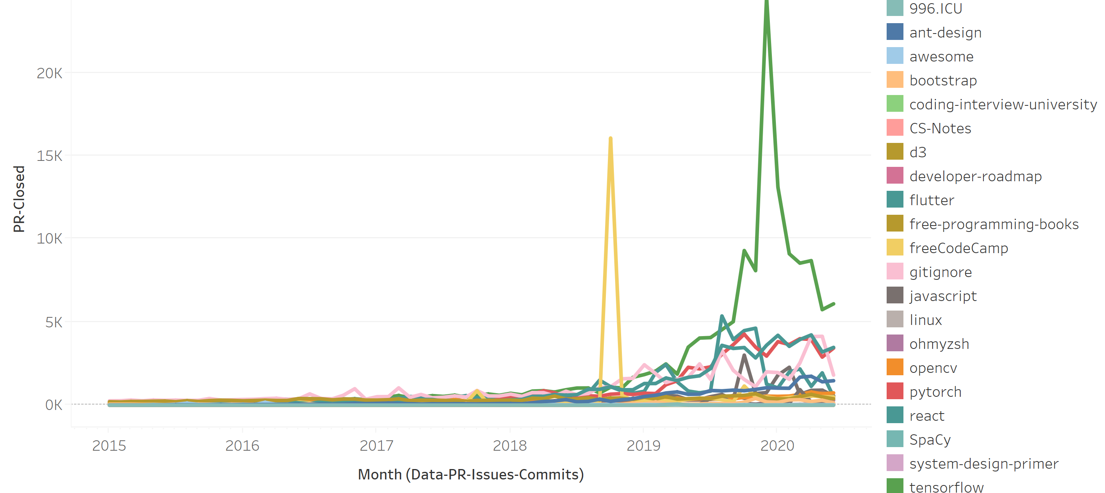
Pull Request Count
Monthly volume of pull requests by repositories

Slide 22
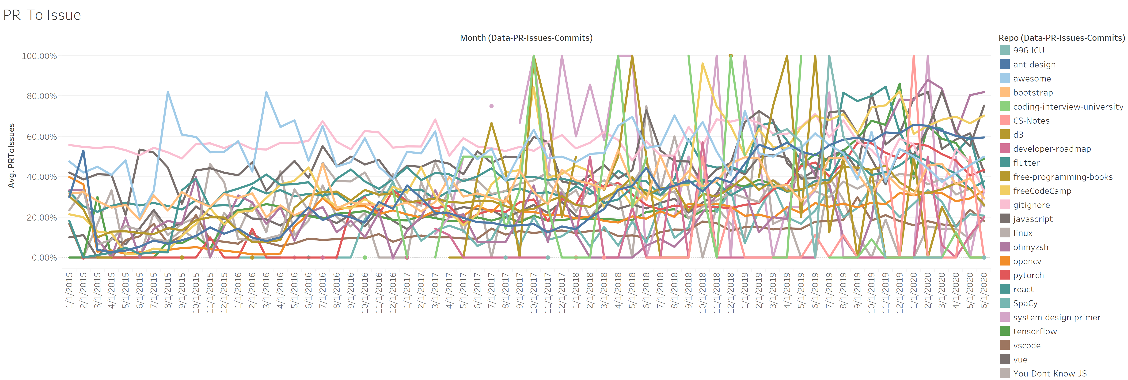
Percent of Pull Requests over Issues

Slide 23
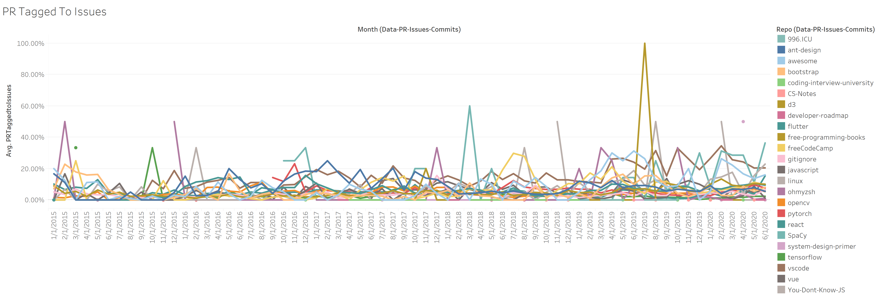
Percent of Pull Requests Tagged to Issues

Slide 24
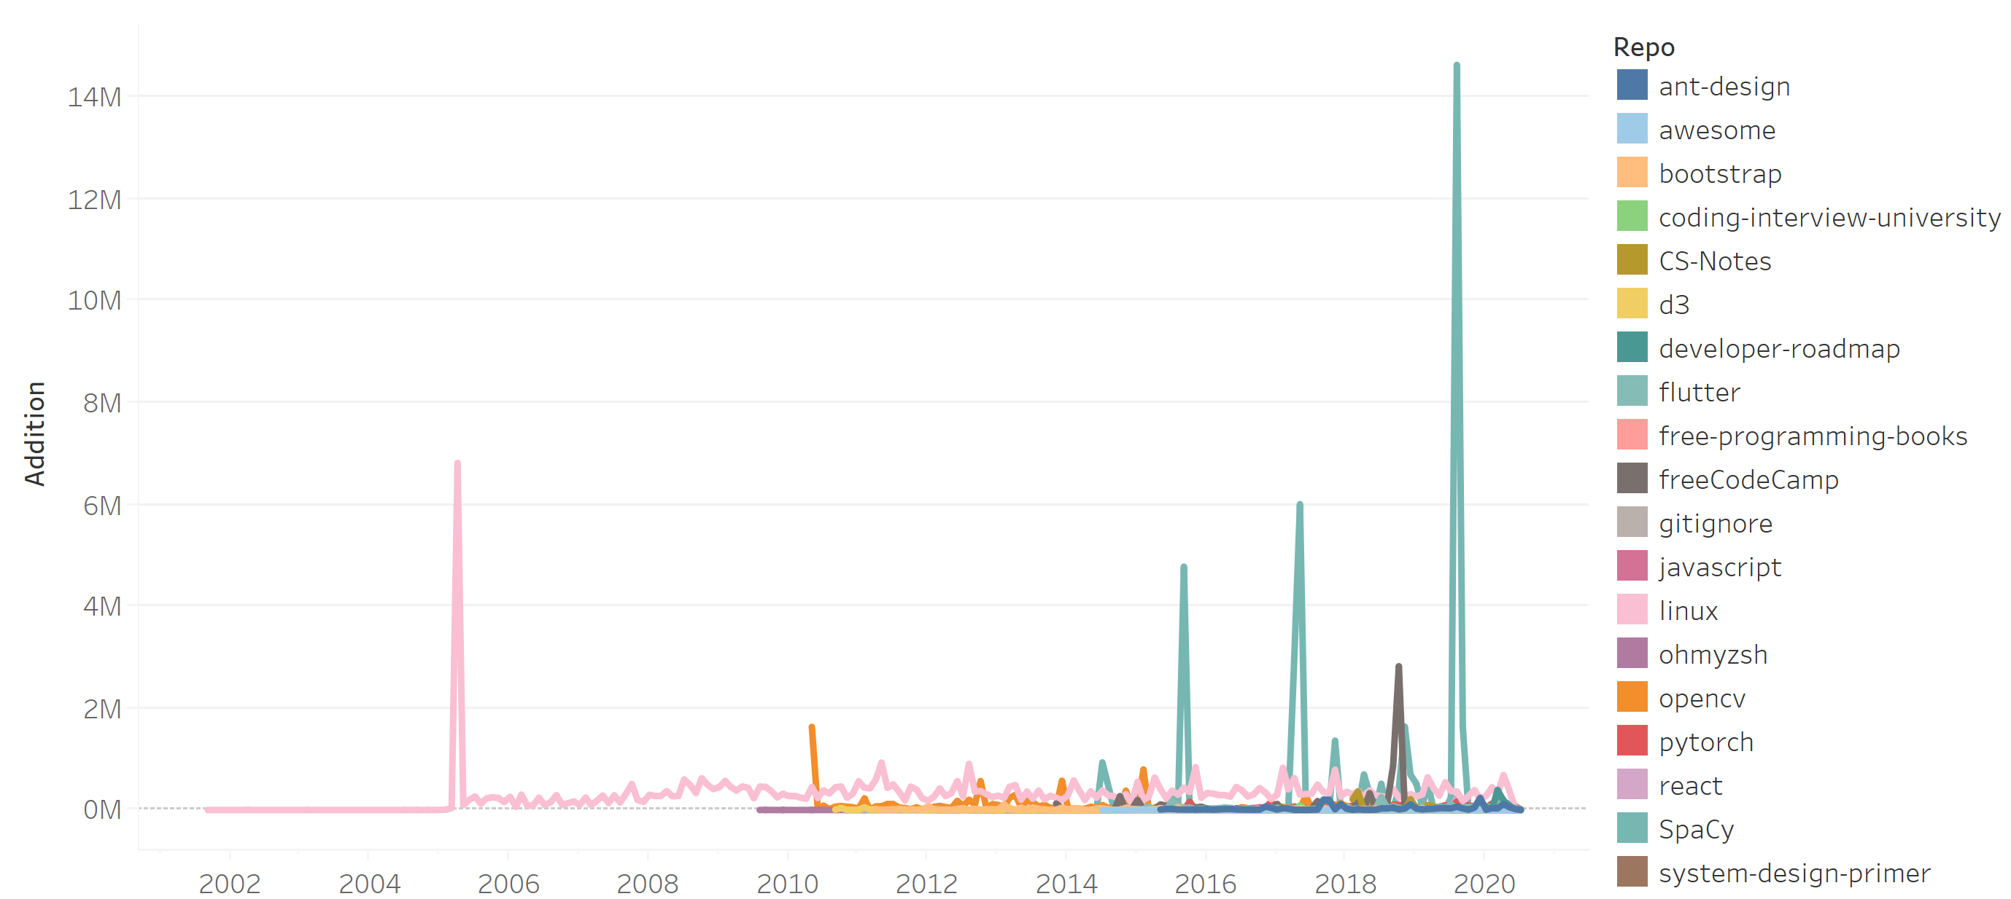
Monthly volume of code addition to repositories

Slide 25
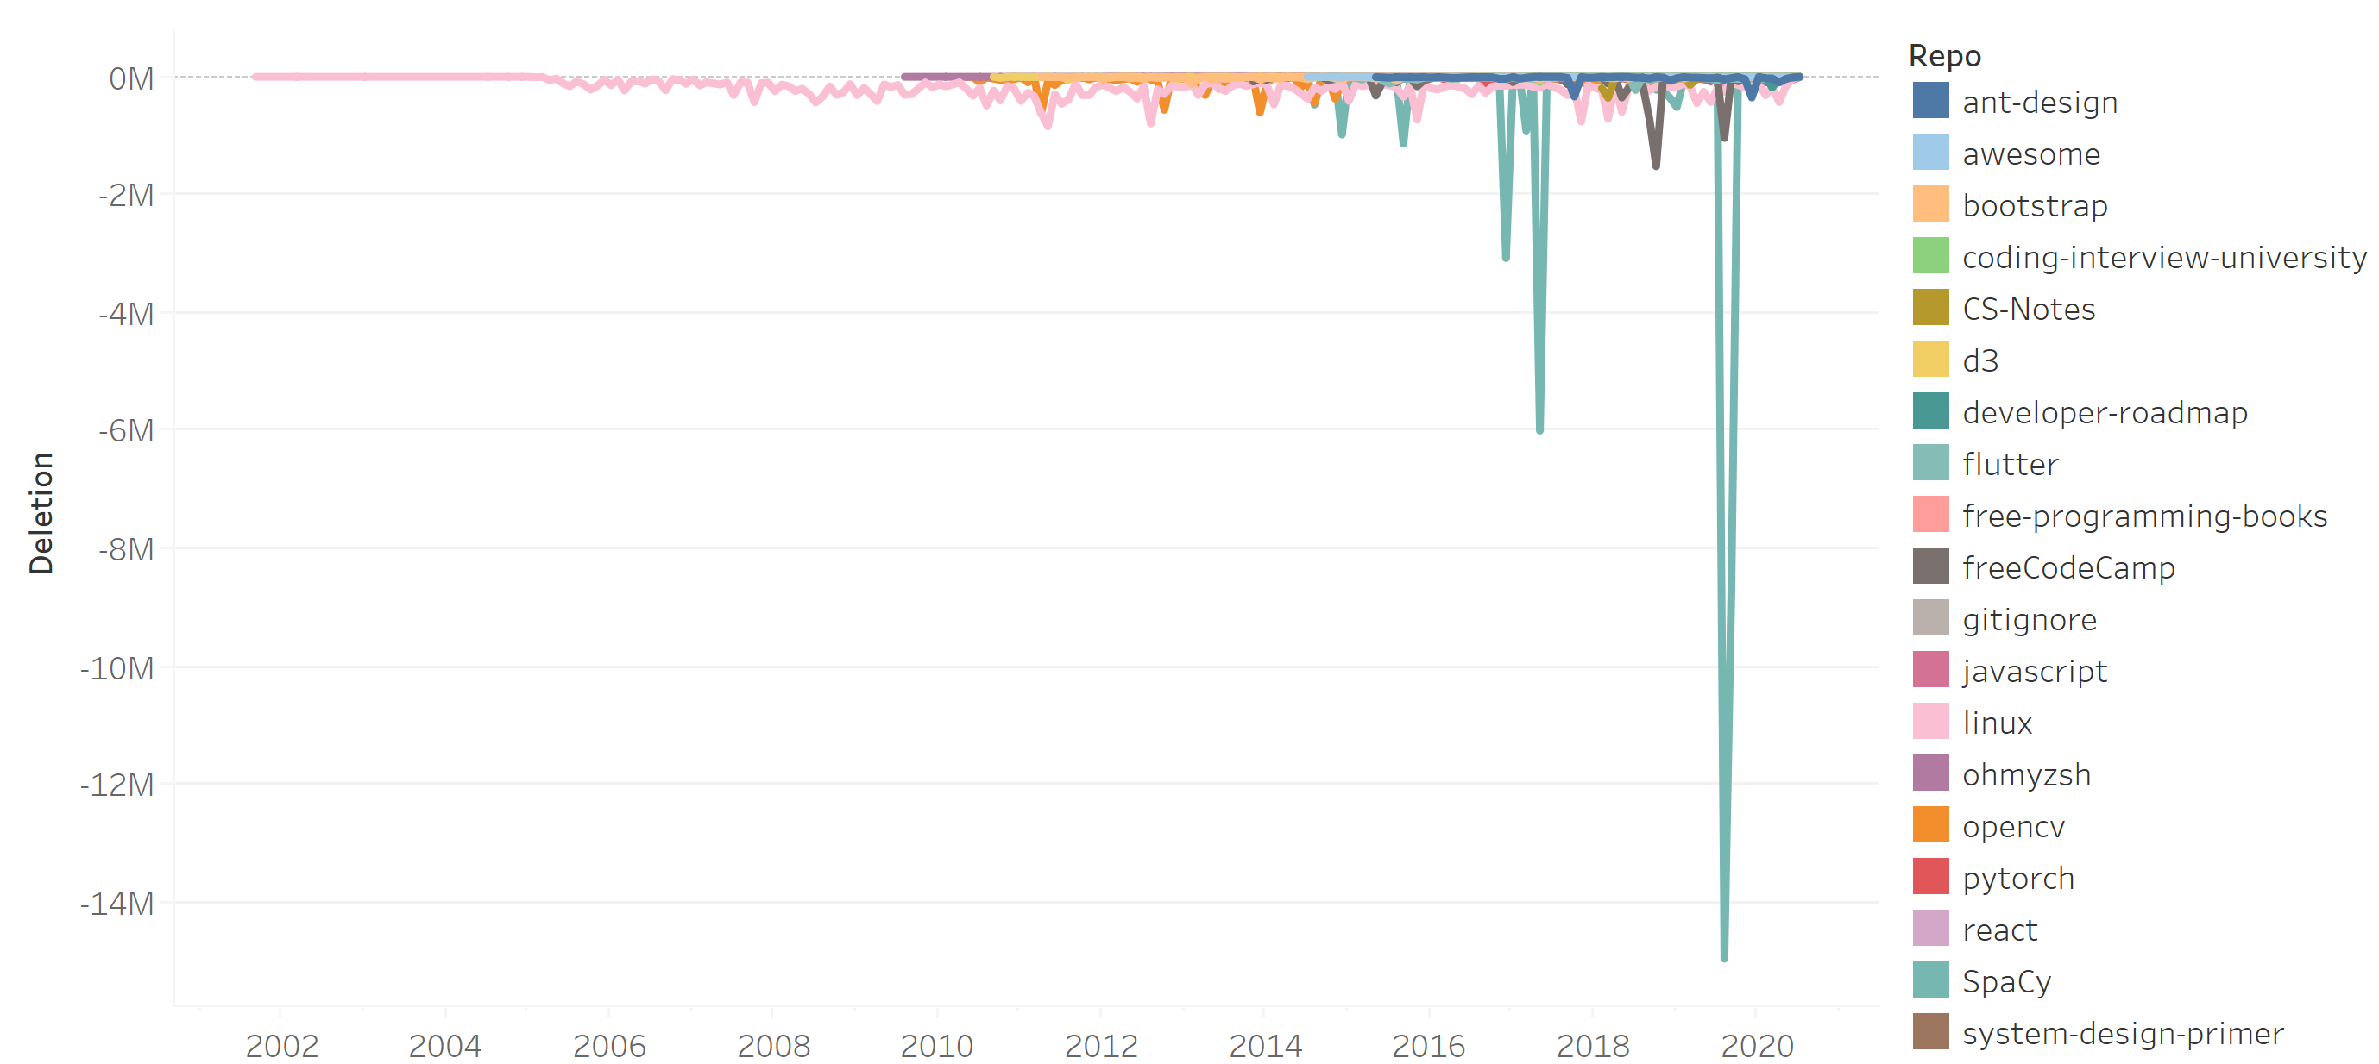
Monthly volume of code deletion to depositories

Slide 26
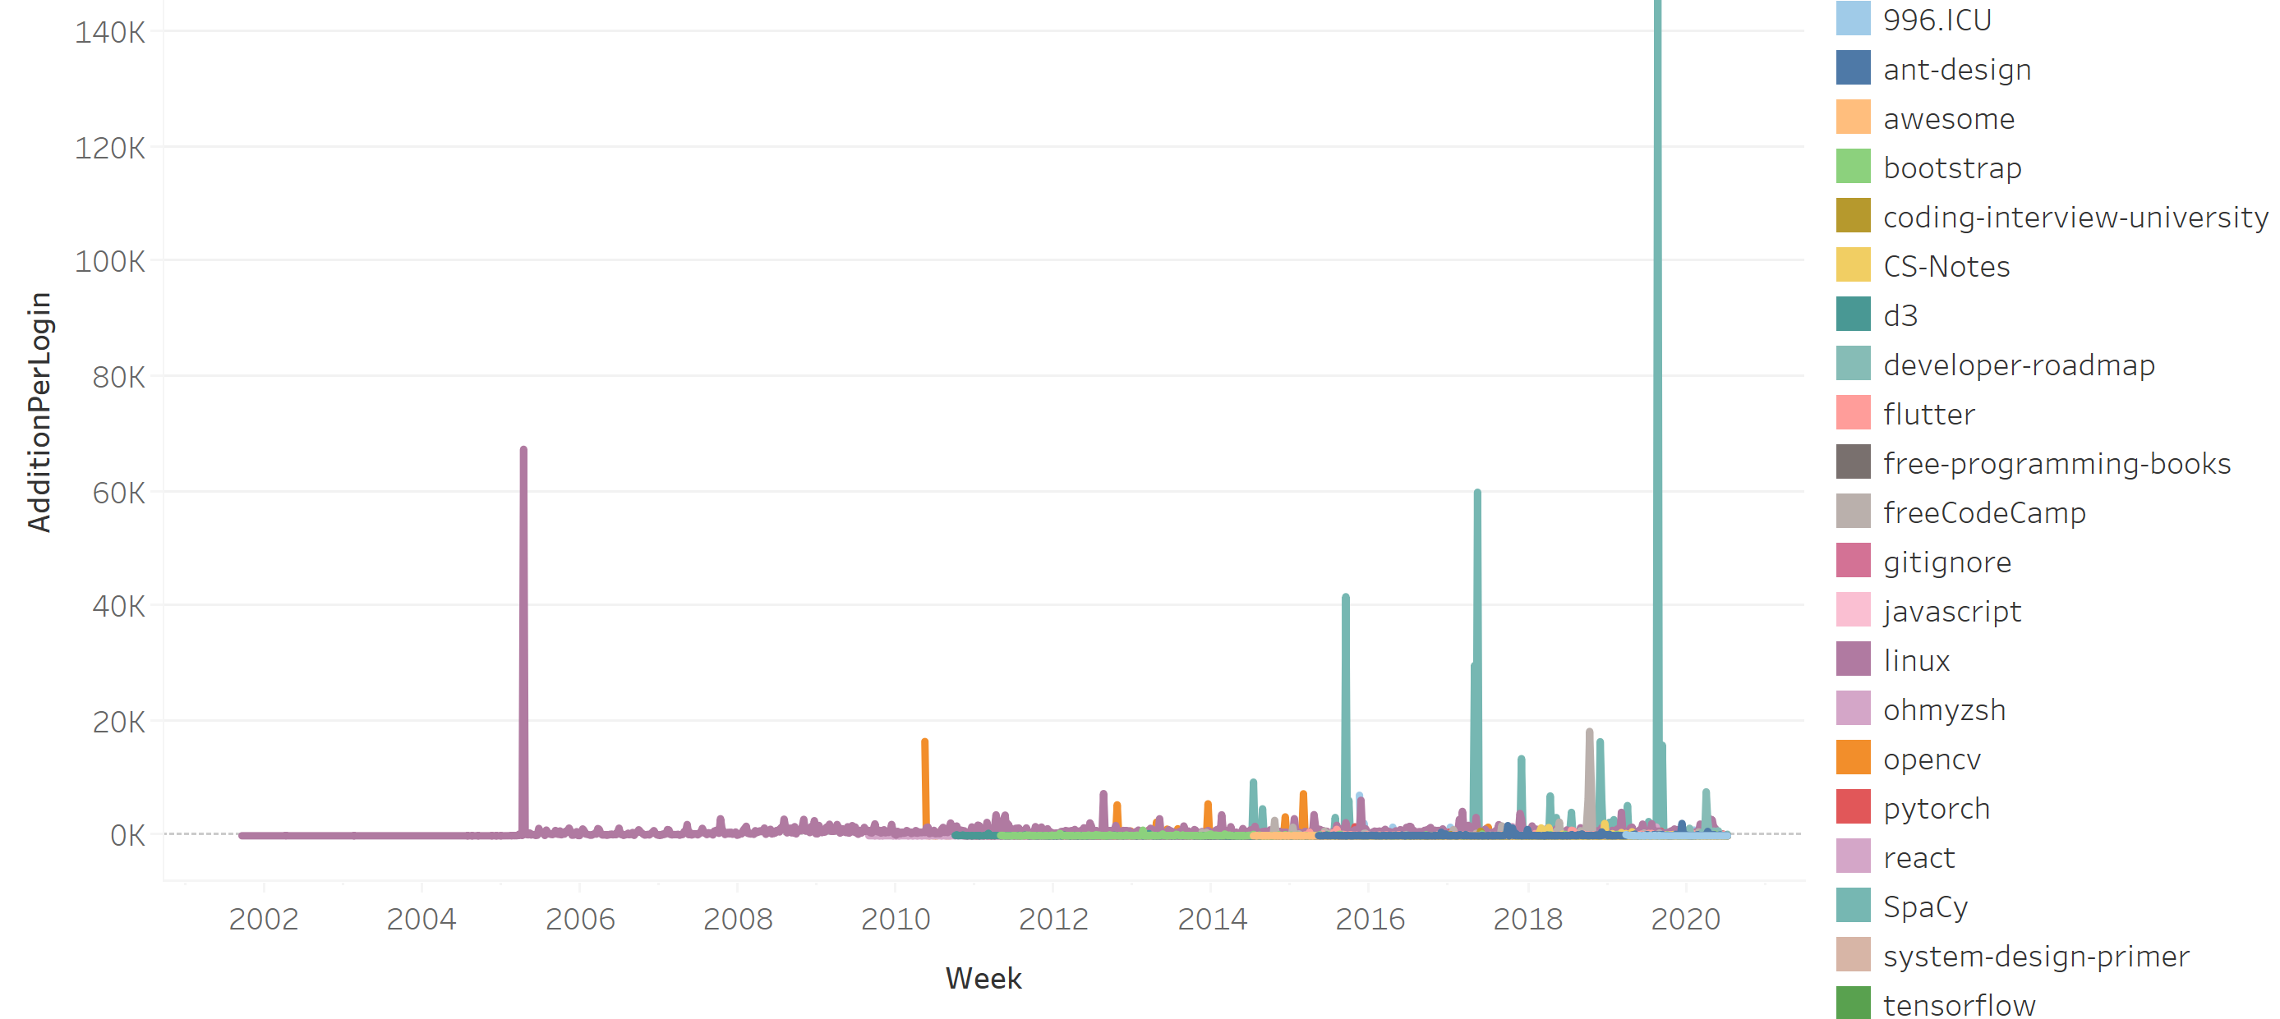
Average Lines of code addition by each contributor

Slide 27
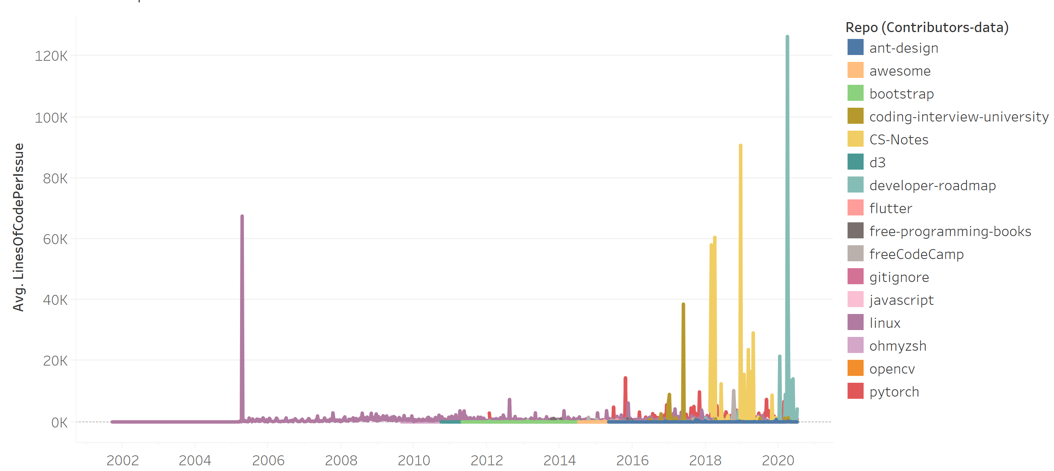
Number of lines code to an Issue

Slide 28
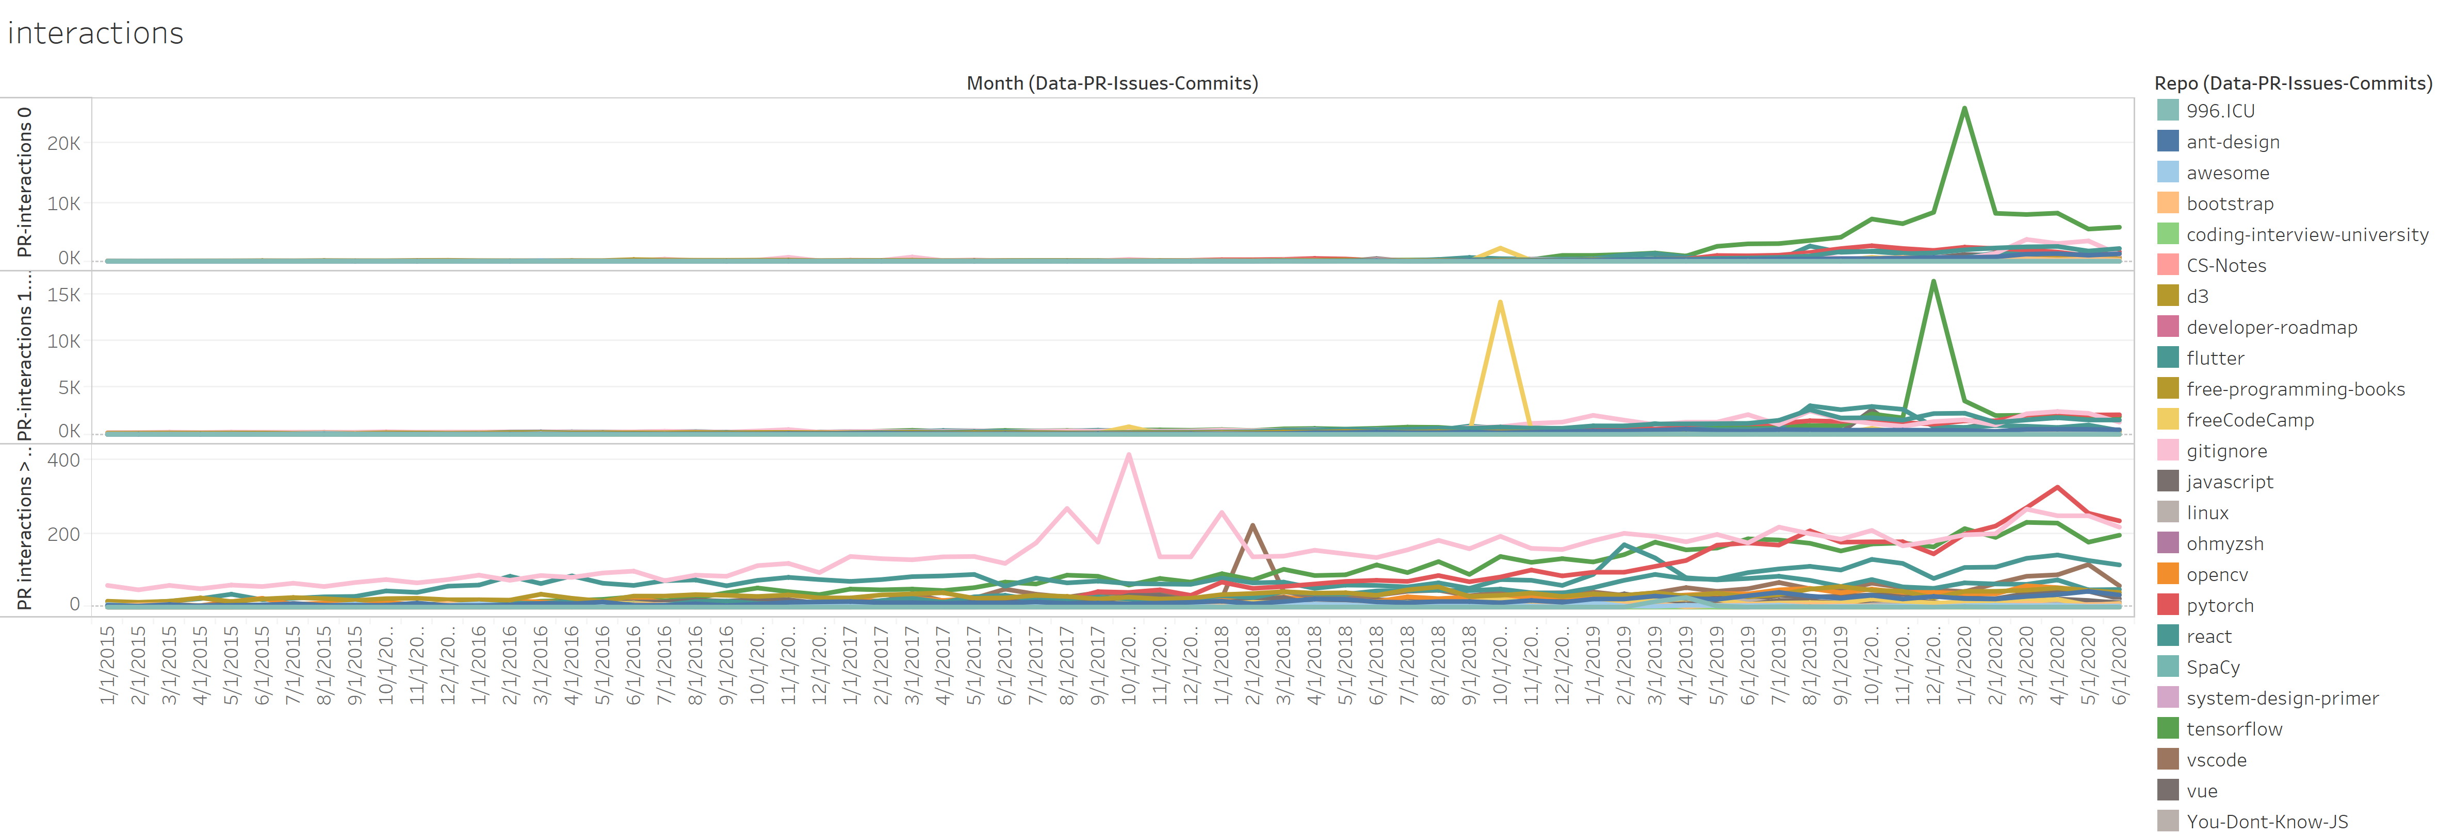
Pull Requests with comments
Top : Pull requests with 0 comments
Middle : Pull Requests with 1-20 comments
Bottom : Pull Requests with > 20 comments

Slide 29
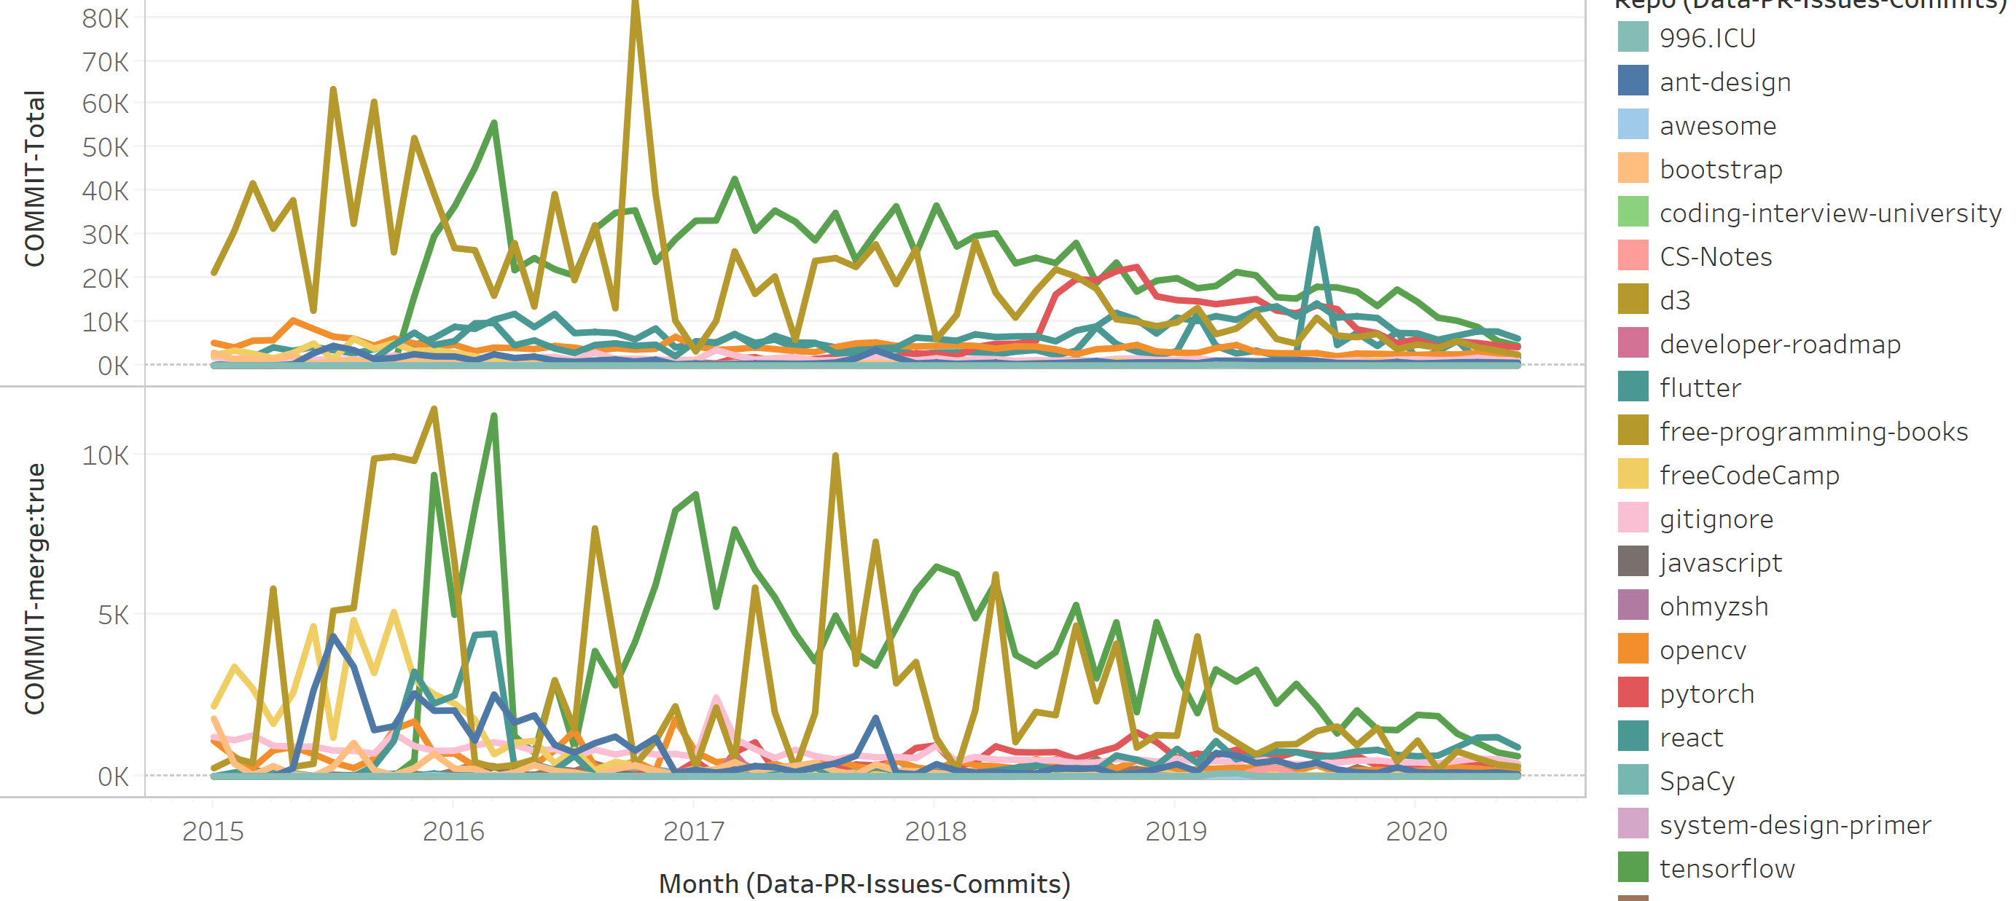
Monthly volume of commits by repository
Linux is excluded – it skews the chart

Slide 30

Individual Contributions
Only commits between 500 and 15k included.

